Slide 1
Capital Improvement Project Proposal Southern Warehouse Cold Storage
Homa Anooshehpoor, Administrator
Division of Food and Nutrition

Slide 2
Southern Warehouse Cold Storage Project
The NDA manages two warehouses that store and distribute food to schools, community organizations, and Tribal communities.
The Northern warehouse, located in Reno, has always had in-house cold storage.
The Southern warehouse, located in Las Vegas, must utilize a third-party contractor for cold storage.

Slide 3
Southern Warehouse Services
The Southern warehouse stores and distributes food for the National School Lunch Program (NSLP) and the Commodity Supplemental Food Program (CSFP) for low-income seniors
CSFP served 2,000 seniors per month in 2021
NSLP served 5,500,964 meals to school aged children in 2022

Slide 4
Southern Warehouse
The Southern warehouse contains 5,150 sq. feet of dry storage space but has no cold storage capacity
The NDA currently leases 2,250 sq. feet of cold storage space from Las Vegas Ice & Cold Storage for $68,000 per year.
This arrangement poses challenges for NDA staff when monitoring inventory, ensuring order accuracy, and tracking best-if-use-by dates

Slide 5
Southern Warehouse
Challenges with Current Arrangement
Over$24,000 worth of food has been lost to the two programs since January 2021 due to improper inventory rotation at the cold storage Facility, resulting in spoilage
Orders pulled by cold storage staff are often incorrect or occasionally contain past-date food, resulting in delivery delays to our partners
NDA staff spend approximately 100 hours per year driving to and waiting at the cold storage facility, putting over 1,000 miles per year on NDA vehicles
A lack of control over the food inventory makes ensuring compliance with federal regulations unnecessarily difficult and time consuming

Slide 6
Proposed Solution
The NDA requests assistance from the State Public Works Division to develop on-site cold storage capacity, in the same location as the Southern warehouse, consisting of:
an engineered concrete supporting six (6) cold storage containers
Containers can serve as coolers or freezers to accommodate all types of products
NDA staff would be able to monitor condition of all products and ensure accuracy of all orders

Slide 7
Current Warehouse Dry Storage

Slide 8
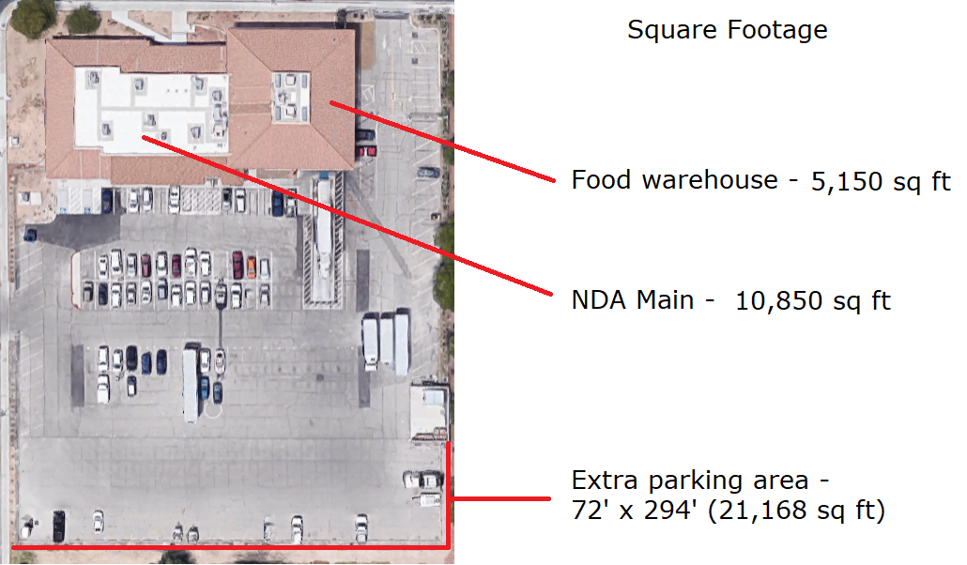
Las Vegas Property & Proposed Location
Proposed Location For Cold Storage

Slide 9
Proposed Cold Storage Location

Slide 10
Consequences If Not Approved
Without an onsite solution, the NDA will continue to encounter inventory loss and compliance issues, placing federal program funding at risk.

